Slide 1
Automated Data Extraction Solution for Real Estate Transactions Solution Workflow, Architecture & POC Costs
For DC Byte
Version 1.0 16Oct2025

Slide 2


POC Objectives
To demonstrate Merit capabilities to automate the end-to-end data collection and extraction process from various online sources and enrichment of data through primary and secondary manual research:
Monitor sources and aggregate data at scale from diverse global online and offline sources
Ensures completeness by covering both public and private sources
Guarantees accuracy through de-duplication and normalisation using automated validation checks and manual QC
Enriches content through multi-lingual discovery using geo-specific keywords and native languages
Value added content through additional manual research (primary and secondary) for missing details
Consistently delivers a structured dataset enriched with metadata, which can be queried

Slide 3
POC Scope and Data Source Categories
Scope: Automated data extraction of real estate or land transactions including expansions in the following US states Virginia, Texas, Arizona, Georgia, Ohio from online sources as shown below, subsequent data enrichment through manual research of non-public sources and the resultant data sets delivered as CSV file uploaded to a SFTP location.
Search & Discovery Methods: SERP API (Google/Bing), OpenSearch, manual primary and secondary research (non-public sources) – up to 20 pages
LinkedIn: LinkedIn Open Search results page, 20 SMEs and key companies’ links - Refer Appendix I for list of 20 SME’s
News & Media Outlets: 15 sources - Refer Appendix II
Key Organisation websites: 10 org websites - Refer Appendix III and websites of new companies uncovered (unknown at this stage)
Commercial Data Providers (Enrichment): 20 organisation URLs – Refer Appendix IV
Competitors Website: Data Center Hawk, Data Center Knowledge, Dodge, Baxtel, Data Center Dynamics
Government & Registry Sources: County level and state level land registries of 5 states listed above - Refer Appendix V
Other Social Media: Twitter handles – 20 handles mentioned in Appendix ​VI
Data Points : List of data points mentioned in Appendix VII
Out Of Scope: Crypto mining, data to be flagged as exclude and supplied

Slide 4




Data Extraction Workflow
Discover.
Process.
Check.
Identify and shortlist candidate URLs and relevant navigation workflow – 200 sources
Apply parsing, semantic de-duplication, and LLM-based classifiers / filters (KIAA framework)
Manual QC checks on 50-100% records from the tech solution and manual research
1
2
3
4
5
6
Collect.
Enrich.
Output.
Scrape relevant sources using ScrapeX, Selenium, and API integrations
Fill missing details and value add to partial records using primary and secondary web research
Deliver structured datasets (Excel) with normalised fields uploaded to SFTP

Slide 5
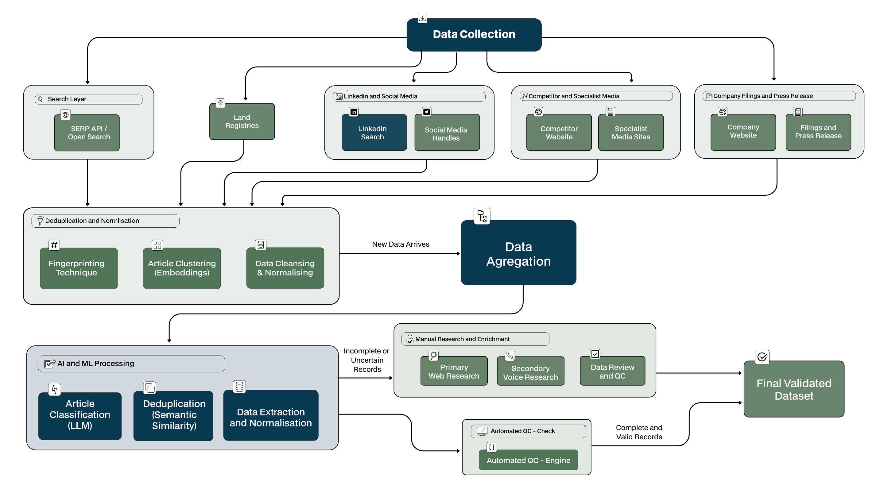
Detailed Data Extraction Workflow

Slide 6
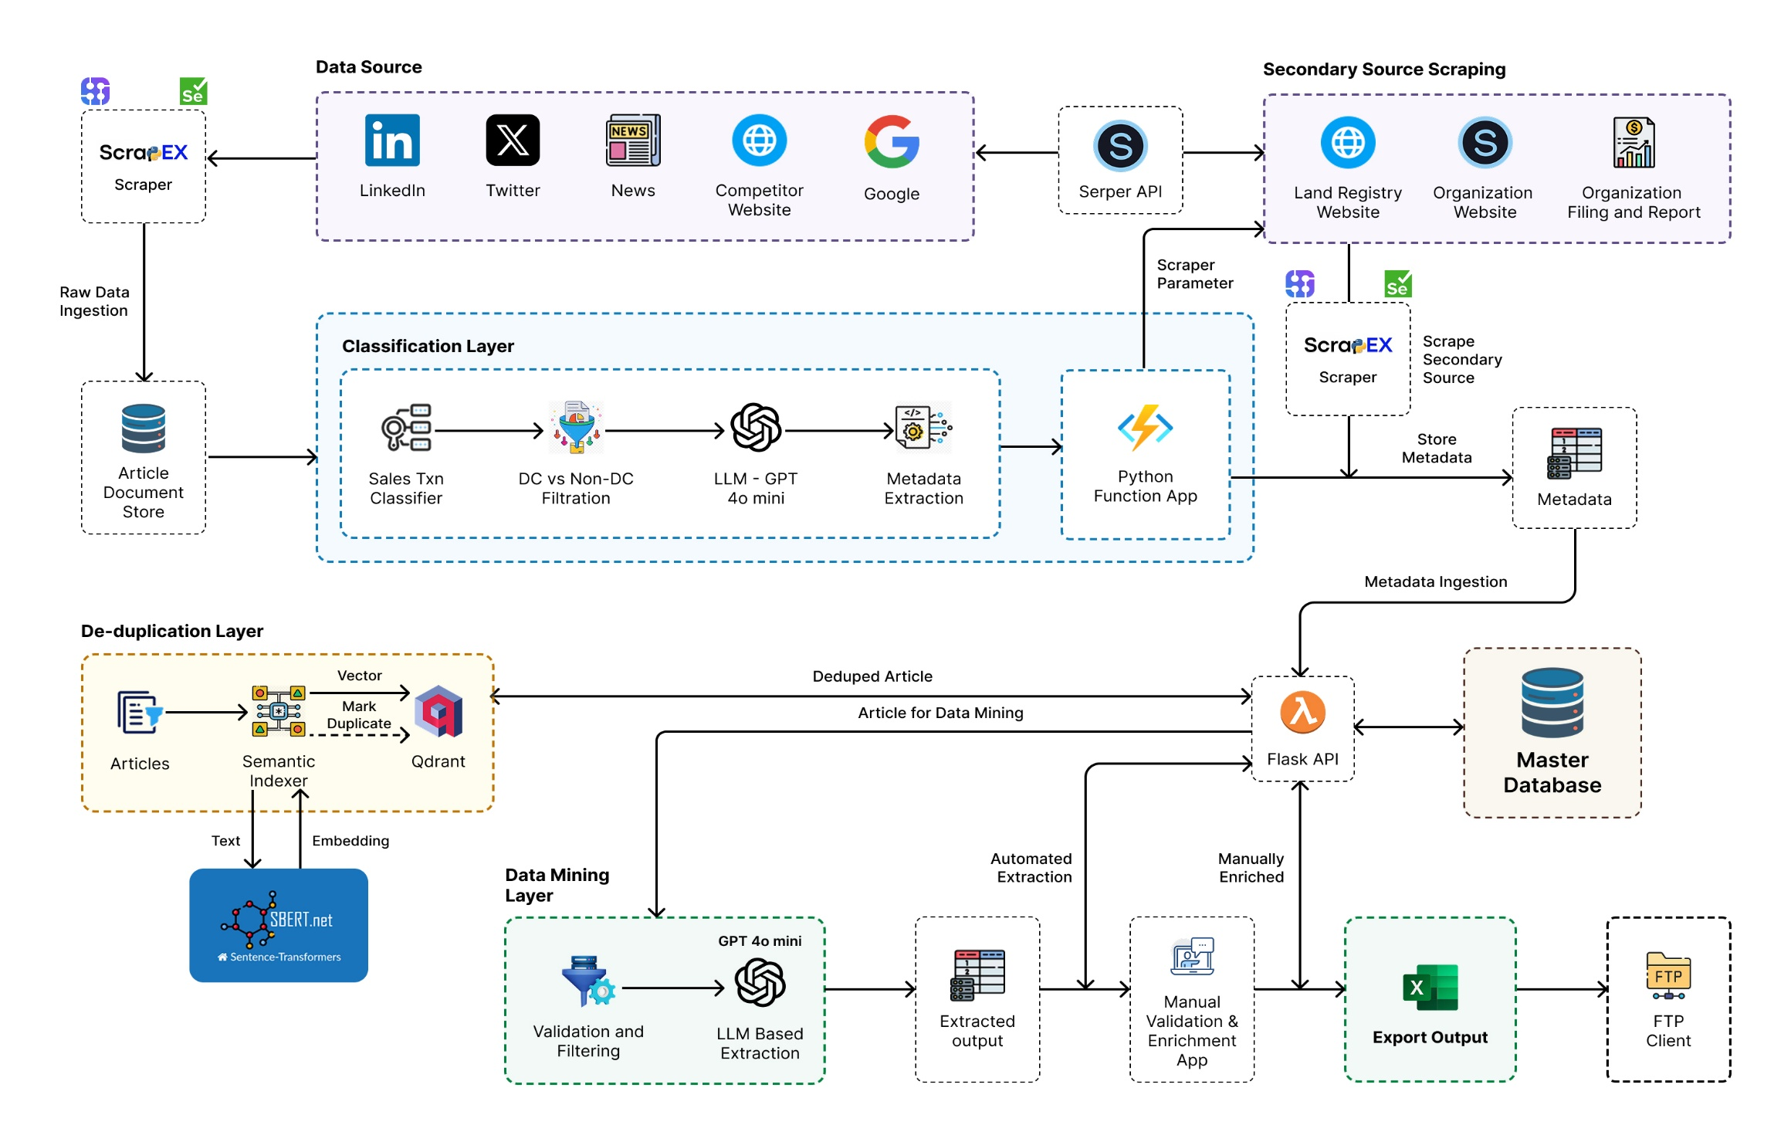
Technical Architecture Diagram
KIAA FW
KIAA FW
KIAA FW
Note: ScrapeX and KIAA platforms are fully owned intellectual property (IP) of Merit Data and Tech Ltd.

Slide 7
POC Deliverables
Output - Unique data records (both complete and partial) delivered as CSV / Excel,with reference links for traceability, delivered in two stages –
Stage I - Post set up, deliver results for UAT(by DCB) from running the tech solution end to end and manual research for POC scope and
Stage II - Regular weekly updates from weeks 9-14
Reporting - High level reporting on Stage I (i.e. after the 8-week solution is set up and run end to end for the first time) includes the number of:
complete and unique records identified through automated tech solution
partial records from the tech solution enriched by manual research
partial records from the tech solution that cannot be enriched by manual research
records added by manual research of non-public sources
records matching existing / live records in DCB platform (i.e. duplicates when compared to the 286 live records)
Reporting - High level reporting on Stage II (i.e. weekly updates (week 9-16) from the recurring run of the tech solution and the manual research cycle (weekly)) includes the number of:
new records added by the tech solution in the week
partial records from the tech solution enriched by manual research in the week
partial records from the tech solution that cannot be enriched by manual research in the week
records added by manual research of non-public sources in the week
Other Metrics – Number of records from each source, no of data fields by source
Note:
All results received from open search and LinkedIn – US
Registry search will be performed only for regions that will be agreed in scope

Slide 8
POC Costs
Description | Cost | Comments
Discovery, Analysis and Planning | FOC
Solution Design and System Set up | £500.00
ScrapeX configuration - c200 sources | £4,120.00 | Refer Appendix I - VI for the full list of sources
AI/ML solution using KIAA framework - classifier, semantic de-duping, data mining | £5,120.00
Solution Testing /QA (Tech) | £800.00
Solution Integration and Deployment | £800.00
Documentation | FOC
Project Management | FOC
Total Solution Customisation and Set Up Costs | £11,340.00
Manual Resource Cost - 2 FTEs @£1,500 Per FTE Per Month | FOC | Manual QC, Prim & Sec Research Non-public Sources
Total Infra Costs | £2,500.00 | Costs for 8 weeks - Ref Appendix VI for Infra Details
Total Cost of POC | £13,840.00 | Ref Slide 12 for POC Timelines

Slide 9
Estimated Full Project Costs – High Level
Description | Cost | Comments
Discovery, Analysis and Planning | FOC | Incl. flights +accommodation for 3 DCB resources for 1week in Chennai
Solution Design and System Set up | £1,600
ScrapeX configuration – c3500 sources (Incl. LinkedIn Links (750), Twitter Handles(750)) | £38,000
AI/ML solution using KIAA framework - classifier, semantic de-duping, data mining | £12,800
Solution Testing /QA (Tech) | £6,400
Automated Validation Checks | £4,500
Solution Integration and Deployment | £4,000
Documentation | FOC
Project Management | £3,850
Total Solution Set Up / Configuration Costs | £71,150 | Note: Includes foreign language sources
Manual Resource Cost (Research only) - 3 FTEs (TBC) | £4,500
Total Infra Costs | £17,400 | Costs for 4.5months - Refer App VIII for Infra Details
Total Cost of Solution Customisation / Configuration | £93,050 | Ref Slide 11 for POC Timelines
Note: A basic user interface (UI) can be customised to facilitate the review and approval of the extracted and supplied final data. The estimated cost for this basic UI component is £8,000.

Slide 10
Estimated Recurring BAU Costs (Monthly) – High Level
Description | Cost | Comments
Licensing Cost | £12,500.00
Estimated Infra Cost (charged on actuals) | £6000.00 | High level estimates but billed on actuals
Manual Resource Cost | XXX | TBC after POC
Total Recurring Cost Including Infra and Manual License Cost | £18,500.00

Slide 11
Key Milestones and Projected Timelines
Milestones | Estimated Duration | Planned Start Date | Planned End Date
POC Milestones and Timelines
POC Solution Configuration | 8 Weeks | 03-Nov-25 | 05-Jan-26
POC UAT (output checks by DCB) | 2 Weeks | 06-Jan-26 | 20-Jan-26
POC UAT Issue Fixes | 1 Week | 21-Jan-26 | 27-Jan-26
Full Project Milestones and Timelines
Final Proposal Discussion Cost Finalisation and Contracts Setup | 4 Weeks | 27-Jan-26 | 27-Feb-26
Full Project Solution Customisation / Configuration | 18 Weeks | 02-Mar-26 | 15-Jul-26
UAT (output checks by DCB) | 4 Weeks | 16-Jul-26 | 14-Aug-26
UAT Feedback Fixes and Deployment | 2 Weeks | 17-Aug-26 | 28-Aug-26
BAU Commencement
BAU Start date | Ongoing Monthly | 01 Sep 26

Slide 12
Appendix I - LinkedIn SMEs/Contacts
Louis Cook
Ben Sooter
Mark Lewis
Michael (Mike) M.
Danny Morgan
José Miguel Corral Ruiz
Edwin Tello
Lewis Vaughan
Patrick McGwan
Matthew Gooding
Jack Baldwin
Lewis Snell
Tom Moriarty
Josh Tomasulo
Ahmed Ayoub
Brody Ford
Reid Lifset
Brad Nowack
Michael Thomas
Joao Xavier

Slide 13
Appendix II – News and Media Outlet Sources
Wall Street Journal
Bloomberg
GlobeNewswire
Business Wire
PR Newswire
Yahoo Finance
Mission Critical
The Real Deal
Commercial Edge
Dallas Business Journal
Phoenix Business Journal
Washington Business Journal
Altlanta Business Chronicle
Columbus Business First
Virginia Business

Slide 14
Appendix III – Key Organisation Websites
Microsoft (microsoft.com / azure.microsoft.com)
Google (cloud.google.com)
Amazon (aws.amazon.com)
Oracle (oracle.com / cloud.oracle.com)
Meta (meta.com (or infrastructure / datacenter subpages))
Equinix (equinix.com)
Digital Realty (digitalrealty.com)
Cyrus One (cyrusone.com)
Iron Mountain Data Centers (ironmountain.com)
STACK Infrastructure (stackinfra.com)

Slide 15
Appendix IV – Commercial Data Providers
CoStar
LoopNet (commercial real estate listings)
Real Capital Analytics (RCA)
PitchBook (for transaction deals)
S&P Global Market Intelligence
Bloomberg Terminal
FactSet
CBRE / JLL proprietary reports
Bloxberg / CB Insights (for tech infrastructure)
Platts / S&P Platts / IHS Markit (for energy / power contracts)
Gridwise / Wood Mackenzie (for energy / grid analytics)
GTM / Greentech Media (for power / renewables, sometimes adjacent)
Inframation (conference / deal intelligence)
Infrastructure Investor (subscriber content)
Data Center Map (paid)
Structure Research (subscription)
451 Research (subscription)
Futurum / Forrester / Gartner (for forecasts)
IDC (for infrastructure / cloud)
Local county / state document scanning services (if they charge for bulk access)

Slide 16
Appendix V – Government & Registry Sources
1) Virginia
Circuit Court Clerk b) Clerk of the Court
c) Links :
https://henrico.gov/services/recording-land-records/
https://www.essexva.gov/clerk-circuit-court/page/land-records?utm_source=chatgpt.com
https://sussexcountyva.gov/department/clerk-of-circuit-court/online-access-to-land-records/?utm_source=chatgpt.com https://www.roanokecountyva.gov/425/Real-Estate-Records?utm_source=chatgpt.com https://www.kwc.gov/361/Land-Records?utm_source=chatgpt.com https://www.registryofdeeds.org/virginia/?utm_source=chatgpt.com https://www.parcelsearch.org/virginia/?utm_source=chatgpt.com
2) Texas
a) County Clerk(Harris, Travis and Dallas) b) County Recorder c) County Deed Records d) GIS
e) Appraisal District f) https://comptroller.texas.gov/taxes/data-centers/data-center-lists.php
3) Georgia
a) County Clerk(Fulton) b) Superior Court Clerk c) Deeds Office(Fulton) d) County Tax Assessor
e) GIS e) Dekalb County f) Gwinnett County
4) Arizona
a) County Recorder(Maricopa & Pima) b) County Assessor c) GIS
d) Planning & Zoning Office e) Pima County Recorder
5) Ohio
a) County Recorder(Franklin & Cuyahoga) b) County Auditor c) GIS
d) Municipal Planning & Zoning, Developer

Slide 17
Appendix VI – Twitter Handles
@Azure (Microsoft Azure)
@AWScloud
@GoogleCloud
@OracleCloud
@Meta (Meta Platforms)
@Equinix
@DigitalRealty
@CyrusOne
@IronMountainDC
@STACKInfra
@Aligned_DC
@EdgeConneX
@CoreSite
@Accesso (Edge / data center firm)
@Powergrid (or local utility corporate handles),
@DataCenterDF (Data Center Frontier)
@DCDnews (Data Center Dynamics)
@CommercialEdge
@MissionCriticalMag
@DCColoNews

Slide 18
Appendix VII – Data Points
Date Of Transaction
Facility Name
Address
Market
Buyer Company
Seller Company
Agents / Advisors Company
Plot Area (ha)/(m²)
Currency
Purchase Price (mil)
Price per m²/Hectare (mil)
Purchase Type
Deals Tags
WAULT
Transaction Note
Source URL
Summary/description
Meta Data

Slide 19
Appendix VIII – Infrastructure Details
S.No | Infrastructure Used During POC | Comments
1 | Proxy Services | Region specific proxies
2 | Virtual Machines(Ubuntu) | B4as v2: 4 vCPUs, 16 GB RAM, 0 GB Temporary storage, £0.127/hour
3 | DB Server | D Series, 4 vCore, £0.2955/hour
4 | Storage
5 | Backup
6 | Twitter Subscription and Apify
7 | Serper(Open Search) API
8 | Linkedin Post Scraping - Subscription
9 | GPU Machines | Intel® Xeon® Gold 5412U GPU: NVIDIA RTX™ 6000 RAM: 128 GB DDR5
10 | Open AI Key

